Slide 1
Vacation Approvals
How to PowerPoint

Slide 2
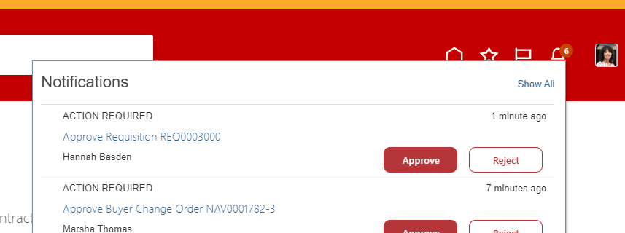
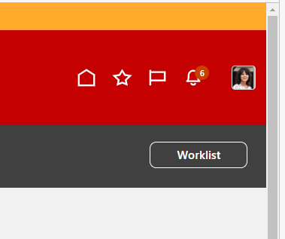
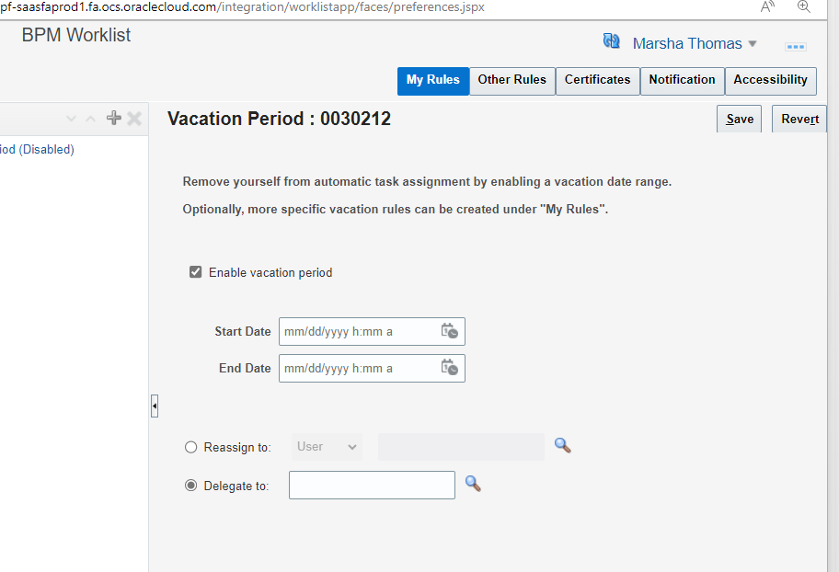
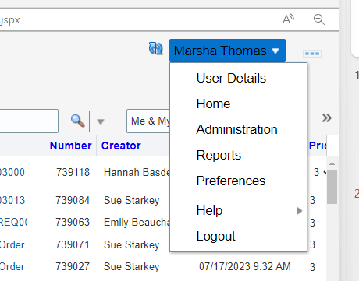
Bell Notification
Click on Show All
Click on Worklist
4) Click on drop box next to your name
5) Preferences
6) Enable Vacation Period
7) Delegate to
8) Save

